Slide 1

CENG 789 – Digital Geometry Processing
05- Mesh Comparison
(Distance, Descriptor and Sampling)
Assoc. Prof. Yusuf Sahillioğlu
Computer Eng. Dept, , Turkey

Slide 2

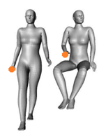
Distances
<number> / 48
Euclidean vs. Geodesic distances.
Euclidean geometry: Distance between 2 points is a line.
Non-Euclidean geom: Distance between 2 points is a curvy path along the object surface.
Geometry of the objects that we deal with is non-Euclidean.
Same intrinsically, different extrinsically:
We use intrinsic geometry to compare shapes as the understanding of a finger does not change when you bend your arm.

Slide 3
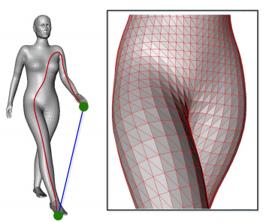
Geodesic Distance
<number> / 48
Intrinsic geometry is defined by geodesic distances: length of the shortest (curvy) path (of edges) between two points.

Slide 4
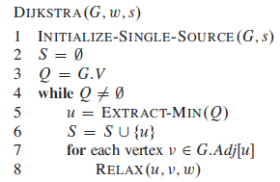

Geodesic Distance
<number> / 48
Compute with Dijkstra’s shortest path algorithm since the mesh is an undirected graph.
v.d is the shortest-path estimate (from source s to v).
v.pi is the predecessor of v.
Q is a min-priority queue of vertices, keyed by their d values.
S is a set of vertices whose final shortest paths from s is determined.
O(VlogV + E) w/ min-heap; O(V² + E) w/ array; E = O(V), discard.

Slide 5
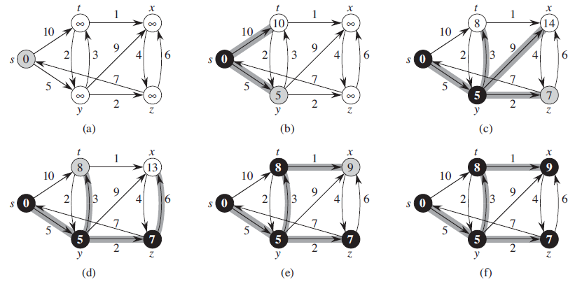
Geodesic Distance
<number> / 48
The execution of Dijkstra’s algorithm (on a directed graph):

Slide 6
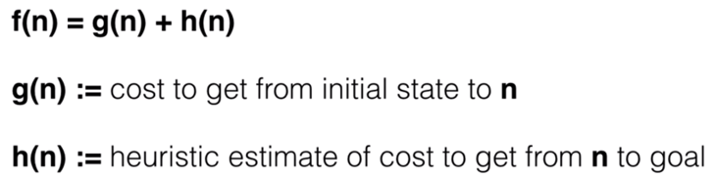
Geodesic Distance
<number> / 48
A* search is an interesting alternative to Dijkstra in which shortest-path estimate value + a heuristic value towards the goal is considered.
See https://youtu.be/ySN5Wnu88nE for a gentle introduction.

Slide 7
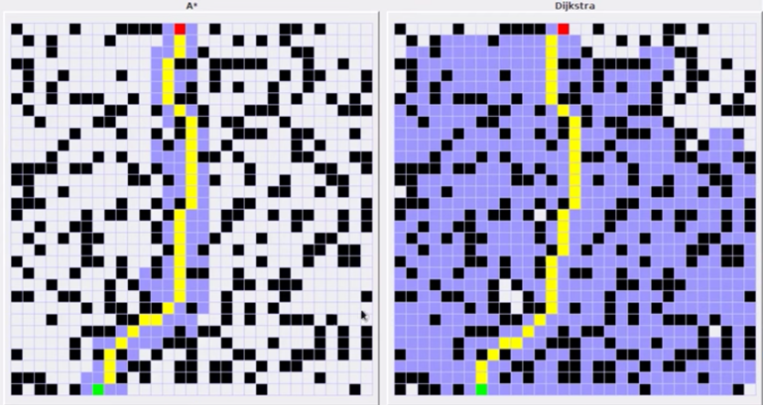
Geodesic Distance
<number> / 48
A* search is an interesting alternative to Dijkstra in which shortest-path estimate value + a heuristic value towards the goal is considered.
Heuristic: Euclidean dist to the red target. Start: green. Visited: purple.

Slide 8
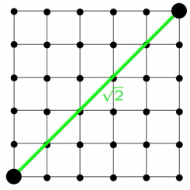
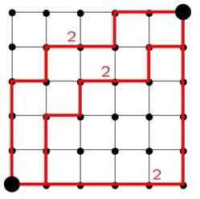
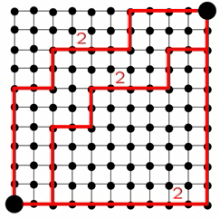
Geodesic Distance
<number> / 48
Does the path really stay on the surface?
Yes, but could have been better if it could go through faces.
Euclidean distance Geodesic distance Geodesic on high-reso

Slide 9
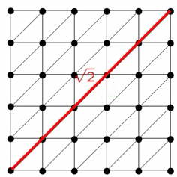
Geodesic Distance
<number> / 48
Does the path really stay on the surface?
Yes, but could have been better if it could go through faces.
Euclidean distance Geodesic distance

Slide 10
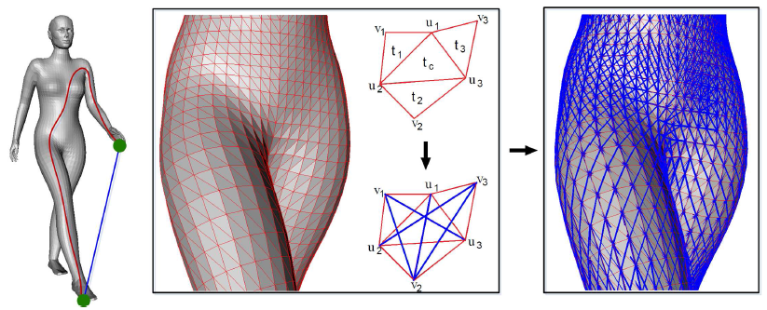
Geodesic Distance
<number> / 48
Does the path really stay on the surface?
Yes, but could have been better if it could go through faces.
Try to add virtual (blue) edges if the 4 triangles involved are nearly co-planar.

Slide 11
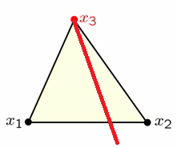
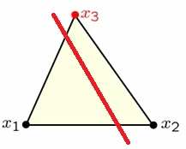
Geodesic Distance
<number> / 48
Fast marching algorithm for more flexible (and accurate) face travels.
  R. Kimmel and J. A. Sethian. Computing geodesic paths on manifolds, 1998.
vs.
Shortcut edge (blue on prev slide) allows face travel starting from a face vertex.
Fast marching allows face travel starting from an arbitrary pnt on the face edge.

Slide 12
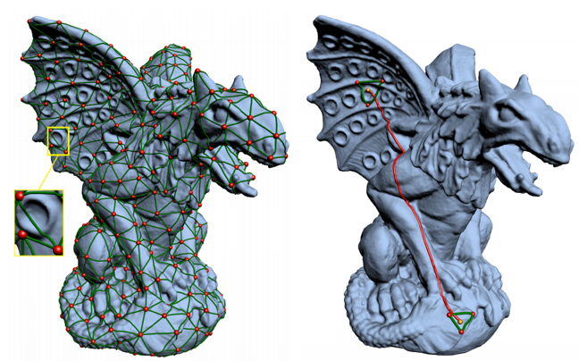
Geodesic Distance
<number> / 48
Exact and approximate algorithms are emerging each year.
See Geodesics in Heat, Saddle Vertex Graph, Wavefront Propagation.

Slide 13
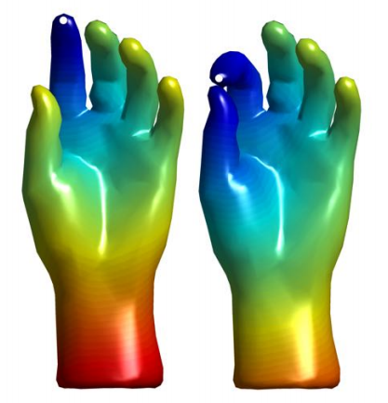
Geodesic Distance
<number> / 48
Main disadvantage: Topological noise changes geodesics drastically.

Slide 14
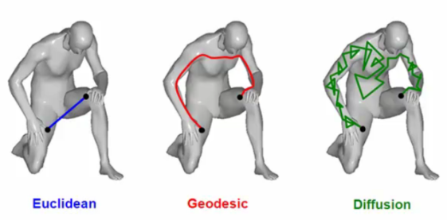
Diffusion Distance
<number> / 48
Principle: diffusion of heat after some time t.
  Geodesic: length of the shortest path.
  Diffusion: average over all paths of length t.

Slide 15
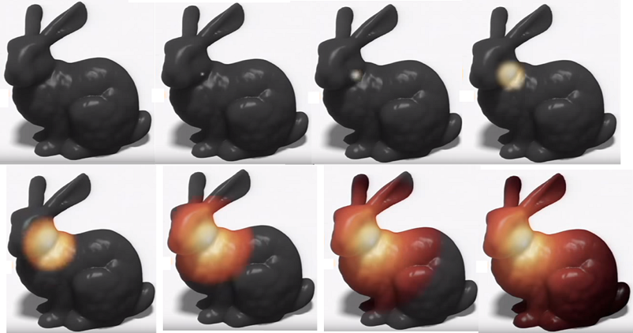
Diffusion Distance
<number> / 48
Principle: diffusion of heat after some time t.
Take a hot needle; touch it to a surface point; watch how heat diffuses out over a time t.

Slide 16
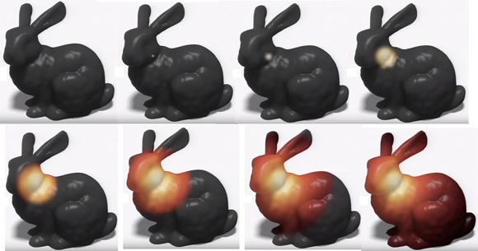
Diffusion Distance
<number> / 48
Principle: diffusion of heat after some time t.
k_{t}(x,y) = probability of Brownian motion of heat starting at point x to be at point y after some time t.

Slide 17
Diffusion Distance
<number> / 48
Principle: diffusion of heat after some time t.
k_{t}(x,y) = amount of heat transferred from x to y in time t.

Slide 18
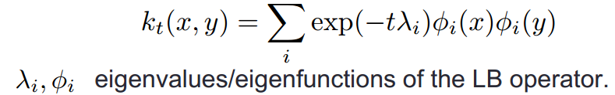
Diffusion Distance
<number> / 48
Principle: diffusion of heat after some time t.
k_{t}(x,y) = amount of heat transferred from x to y in time t.
k_{t}(x,x) = amount of heat remaining at x after time t.
Notes:
See https://hal.inria.fr/inria-00498591/file/RR-7333.pdf (Discrete minimum distortion correspondence problems for non-rigid shape matching; Eq. 2) for discretization of k_{t}(x,y).

Slide 19
Diffusion Distance
<number> / 48
Principle: diffusion of heat after some time t.
k_{t}(x,y) = amount of heat transferred from x to y in time t.
Intuitively, k_{t}(x,y), aka the heat kernel, is a weighted average over all paths between x and y possible in time t, which should not be affected by local perturbations of the surface (small topology noise).

Slide 20
Geodesic Distance
<number> / 48
What can we do with this geodesic?
Descriptor.
Sampling.
Similarity comparisons.
..

Slide 21
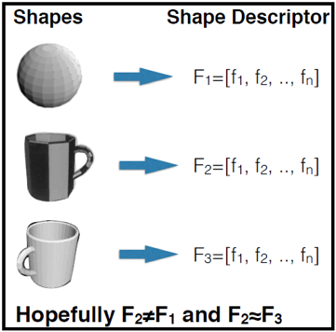
Shape Descriptors
<number> / 48
Local (vertex-based) vs. Global (shape-based) shape descriptors.
Desired properties:
  Automatic
  Fast to compute and compare
  Discriminative
  Invariant to transformations (rigid, non-rigid, ..)

Slide 22
Shape Descriptors
<number> / 48
A toy global descriptor: F = [x1, y1, z1, x2, y2, z2, .., xn, yn, zn].
Desired properties:
  Automatic??
  Fast to compute and compare??
  Discriminative??
  Invariant to transformations (rigid, non-rigid, ..)??

Slide 23
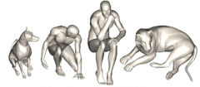
Shape Descriptors
<number> / 48
A toy global descriptor: F = [numOfHandles]. //computable by Euler’s formula.
Desired properties:
  Automatic??
  Fast to compute and compare??
  Discriminative??
  Invariant to transformations (rigid, non-rigid, ..)??

Slide 24
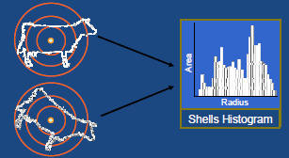
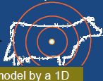
Shape Descriptors
<number> / 48
Global descriptors.
shape histograms
area/volume intersected
by each region stored in a
histogram indexed by radius

Slide 25
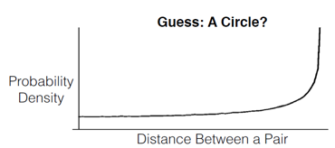
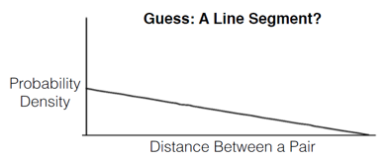
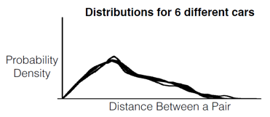
Shape Descriptors
<number> / 48
Global descriptors.
shape distributions
distance between 2 random
points on the surface
angle between 3 random
points on the surface
..

Slide 26
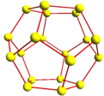
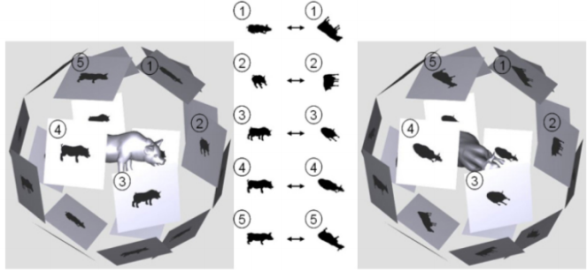
Shape Descriptors
<number> / 48
Yet another global descriptor: LightField Descriptor
10 silhouette images rendered from vertices of a hemisphere.
  Rotation-invariant.

Slide 27
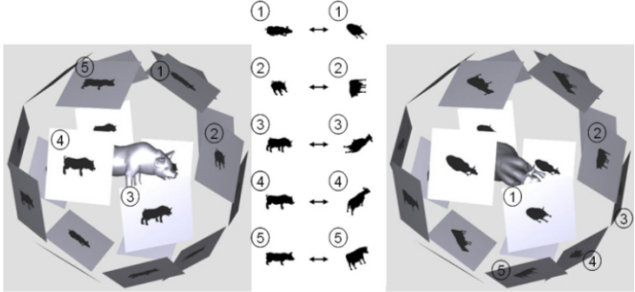
Shape Descriptors
<number> / 48
Yet another global descriptor: LightField Descriptor
10 silhouette images rendered from vertices of a hemisphere.
  Rotation-invariant.

Slide 28


Shape Descriptors
<number> / 48
Yet another global descriptor: LightField Descriptor
10 silhouette images rendered from vertices of a hemisphere.
  Rotation-invariant.
  Dissimilarity b/w two 3D models: .

Slide 29

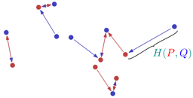

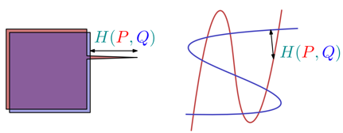

Shape Descriptors
<number> / 48
Global descriptor for pairwise sim.: Haussdorf distance b/w 2 models.
Find closest pnts of each red (min), and then each blue (min). Pick the max of the most widely separated closest pnts (max).
Advantage: considers all boundary points, mutual proximity.
Disadv: sensitive to outliers; sometimes unnatural (not rigid invariant).
Can be made transf-invariant if minimized through all transformations.

Slide 30
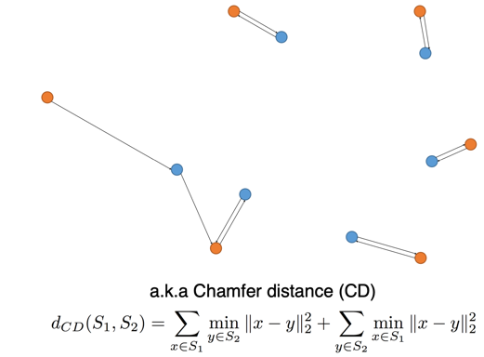
Shape Descriptors
<number> / 48
Global descriptor for pairwise sim.: Chamfer distance b/w 2 models.
Find closest pnts of each red (min), and then each blue (min). Pick the sum of these sums, i.e., replace max of Haussdorf w/ additions.
Intuitively may appear more robust to outliers, still quite sensitive.

Slide 31

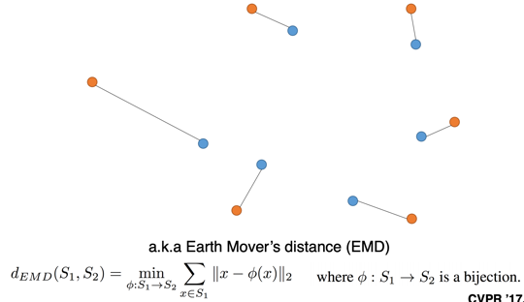
Shape Descriptors
<number> / 48
Global descriptor for pairwise sim.: Earth Mover’s dist. b/w 2 models.
Cost of changing one shape to another.
Measure total length of matched dists, minimized over all bijections.
May be more natural than Hausdorff, but harder to compute.
Points may have weights.

Slide 32
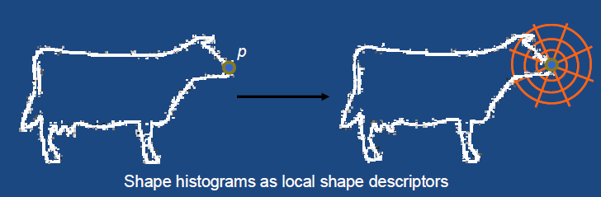
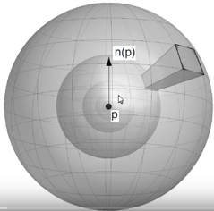
Shape Descriptors
<number> / 48
Global descriptor to a local descriptor: center it about p.
Count points in different sectors of a sphere: shape contexts.

Slide 33
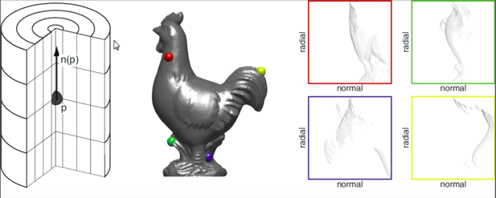
Shape Descriptors
<number> / 48
Global descriptor to a local descriptor: center it about p.
Spin Images: Count 3D points falling inside that solid ring.
  Go this far in normal direction, and this far in radial direction.
Shape contexts in the following part of this video
Notes:
https://youtu.be/7b2OupI6gKw?t=12m39s

Slide 34
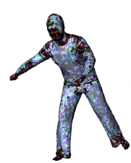
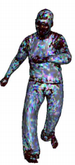
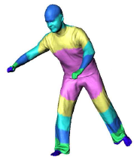
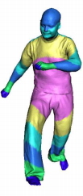
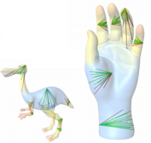
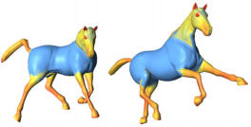
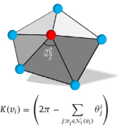
Shape Descriptors
<number> / 48
Local shape descriptors.
  Curvature Average Geodesic Distance Shape Diameter (SDF)
  sum of geodesics from
  v to all other vertices.
  sum of ray lengths from v.

Slide 35
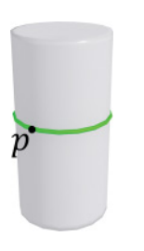
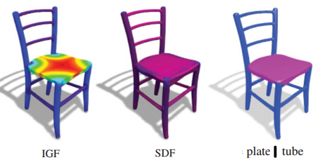
Shape Descriptors
<number> / 48
Local shape descriptors.
  Intrinsic Girth Function Combine with SDF to detect plate/tube
  Shortest geodesic Big IGF(p), small SDF(p) ➔ plate
  starts & ends at p. Small IGF(p), small SDF(p) ➔ tube

Slide 36
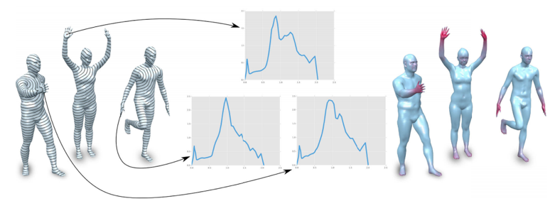
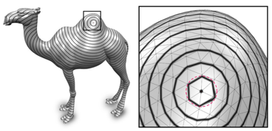
Shape Descriptors
<number> / 48
Local shape descriptors.
  Geodesic Iso-Curve Signature

Slide 37
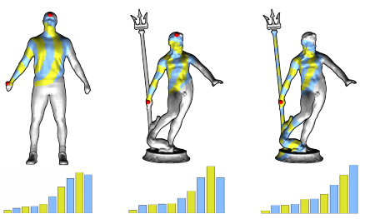
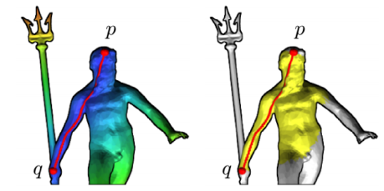
Shape Descriptors
<number> / 48
Local shape descriptors.
  Bilateral Maps
  vs.

Slide 38
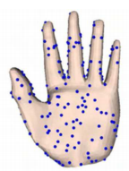




Sampling
<number> / 48
Subset of vertices are sampled via
  Evenly-spaced Curvature-oriented Farthest-point
  sampling evenly-spaced sampling sampling (FPS)
  Uniform
  sampling
Uniform sampling: Pick triangles w/ probabilities proportional to their areas; then put a random sample inside the picks.
FPS: Eldar et al., The farthest point strategy for progressive image sampling.

Slide 39
Sampling
<number> / 48
FPS idea.
You have V vertices and N samples; want to sample the (N+1)st.
V-N candidates.
Each candidate is associated with the closest existing sample.
  Remember the distance used in this association.
As your (N+1)st sample, pick the candidate that has the
max remembered distance.
If geodesic distance is in use (more accurate):
  O(NV + NVlogV) = O(NVlogV) complexity.
Else if Euclidean distance is in use:
  O(NV) complexity.
  Cost of finding the max distance for each new sample: O(NV), no additional Dijkstra geodesic computation.

Slide 40

Sampling
<number> / 48
Can we get this sampling via FPS?

Slide 41

Sampling
<number> / 48
Can we get this sampling via FPS?
No.
Use local maxima of Average Geodesic Distance descriptor
Use local maxima of heat kernel signature (Slide 16), a multiscale descriptor similar to Geodesic Iso-Curves.

Slide 42



An Application: Shape Correspondence
<number> / 48
Feature-based and/or distance-based algorithms for shape correspondence, an important problem in computer graphics.

Slide 43

An Application: Shape Correspondence
<number> / 48
Feature-based: match the points with close feature descriptors.
Pointwise term, i.e., involves 1 point at a time.

Slide 44

An Application: Shape Correspondence
<number> / 48
Distance-based: match 2 points with compatible distances.
Pairwise term, i.e., involves 2 points at a time.

Slide 45




An Application: Shape Correspondence
<number> / 48
Feature- and distance-based: a combination of both.

Slide 46




An Application: Shape Correspondence
Let’s see a useful pairwise term in action.
  Copied from my paper talk: A Genetic Isometric Shape Correspondence Algorithm with Adaptive Sampling, SIGGRAPH Asia, 2018.
s_{i}
t_{j}
t_{m}
|.35 - .95| = .6 ☹
|.34 - .48| = .14 ☹
s_{l}
s_{i}
s_{l}
A bad/high-distortion map.
t_{m}
t_{j}

Slide 47


An Application: Shape Correspondence
<number> / 48
Interpolation of a sparse correspondence into a dense one.
Compute for each vertex on M1 the geodesic distances to all sparse correspondence points on M1, and then establish a correspondence to the vertex on M2 with the most similar distances to sparse correspondence points on M2.

Slide 48
Potential Project Topics
<number> / 48
Implement paper: Constant-Time All-Pairs Geodesic Distance Query On Triangle Meshes (Figure in Slide 12).
Implement paper: Intrinsic Girth Function for Shape Processing.
Given the shape, computing the descriptor is easy. How about the inverse problem: given the descriptor(s), compute the shape?
  Inspiration: these slides and/or some Shape Registration slides.

